Slide 1

PHP
CHAPTER 5 – CONNECT TO SQL SERVER

Slide 2






PHP COURSE ROADMAP
WEB SERVER
CLIENT
REQUEST
CHAPTER 2
CHAPTER 4
CHAPTER 3
WEB
FORMS
EXECUTE PHP CODE
CHAPTER 1
MANUPULATE
DATA
WEB COOKIES
EXTRA
RESPONSE
GENERATE HTML
CHAPTER 1

Slide 3

OBJECTIVES FOR TODAY
Connect PHP to database
Run SQL queries on PHP code
Get results from querries

Slide 4


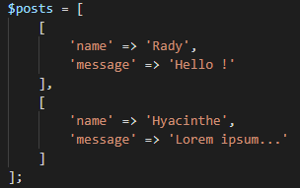
Activity 1
EXPLORE
15 MIN
INDIV
Can you create and display many posts ?
Can you share posts with your friends if you share the link of your server ?
What do you think about the variable $posts ? How long is its lifetime ? How many posts are stored ?
Does the server store the data from request parameters ($_POST) ?

Slide 5




EXPLAIN
PHP without database
15 MIN
CLASS
$_GET $_POST
+
For each PHP run, the variable $posts is reset
PHP get the parameters from $GET or $POST
PHP generates a HTML file from the PHP code
Fish memory !
We cannot keep anything on server side

Slide 6


PHP with database
$_GET $_POST
+
+
PHP get the parameters from $GET or $POST
PHP requests queries to the database on server
PHP generates a HTML file from the PHP code
Elephant memory !
Now we can keep and remember values on server side !

Slide 7
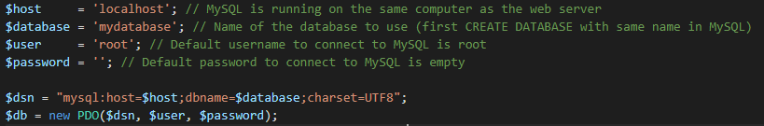
1 - Connect to database
PDO need parameters to know how to connect to the good database
PDO is an interface for accessing databases in PHP
With the new keyword, you create a new connection
Store the returned value in a variable $db, we will use it to execute SQL queries on the database !

Slide 8
2 – Execute a query
The $db->query() will execute a SQL query from PHP code

Slide 9
2 – Execute a query
To insert data, just concatenate the data with the query:
Same as:

Slide 10
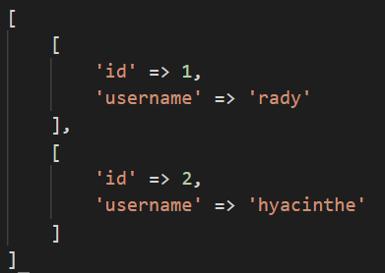
3- Get results from query
The fetchAll() function returns an array of associative arrays of query results
If you expect only one record as result, you can use the $statement->fetch() function instead

Slide 11
SQL table to PHP arrays
id | username
1 | rady
2 | hyacinthe
fetchAll()
Users Table
$user_list

Slide 12
Activity 2
PRACTICE
15 MIN
INDIV
Add database in the project from activity 1:
Create a new database PHP_connect in MySQL
Create table posts (from posts.sql file)
Complete the PHP code

